Slide 1
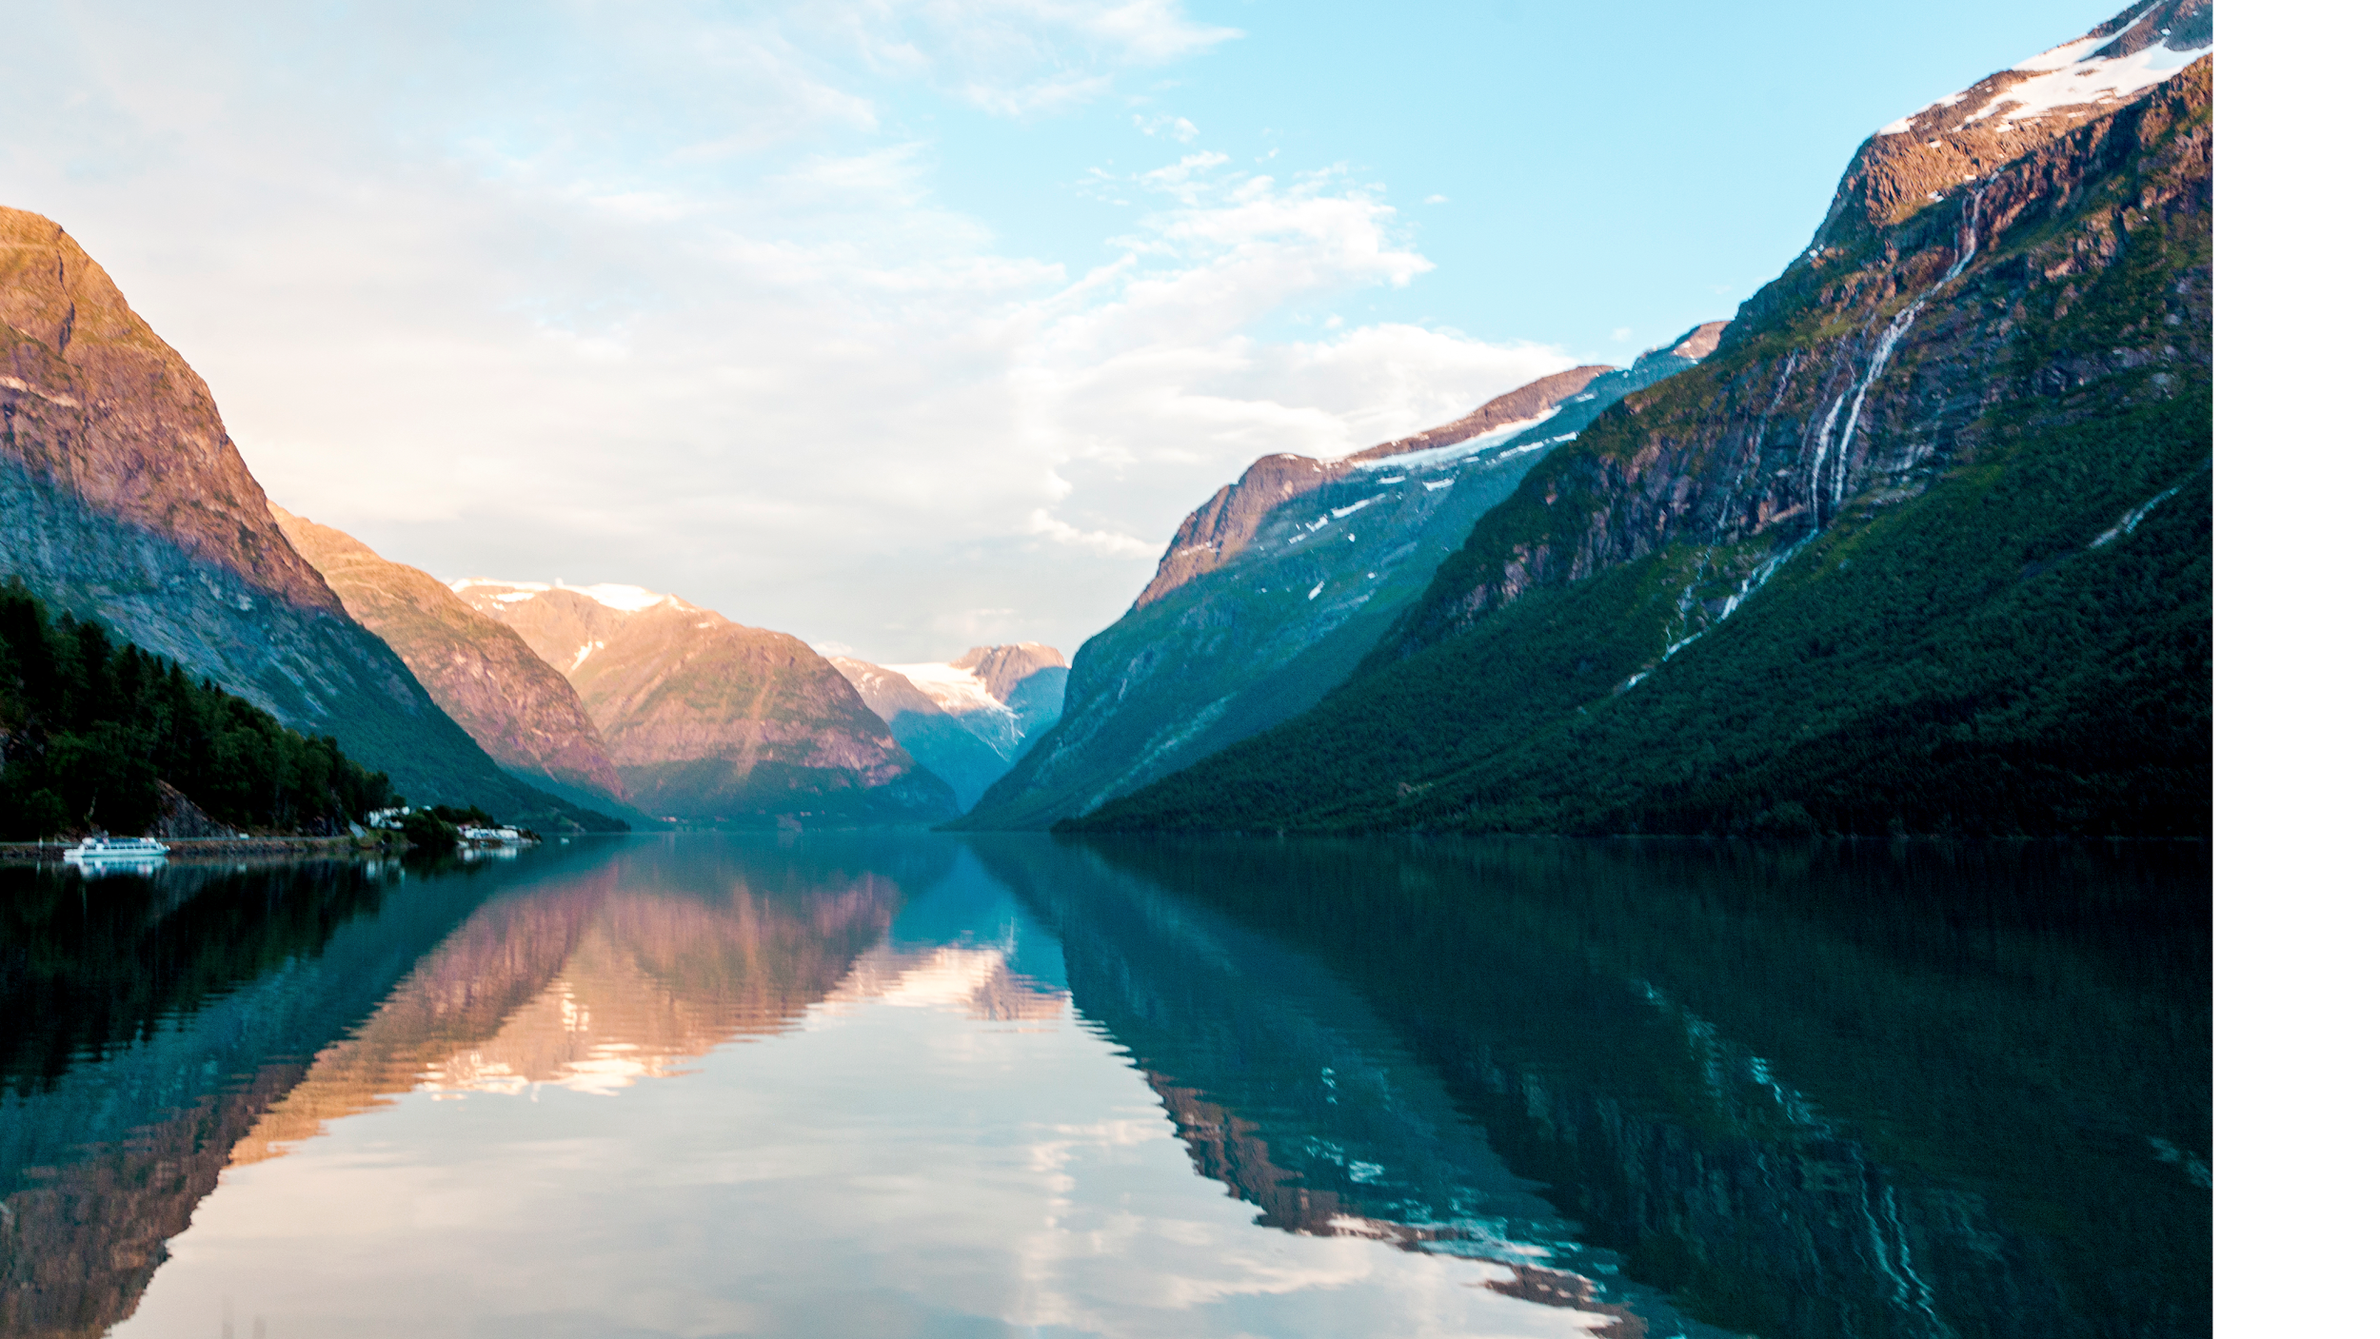
Detecting Anomalies in Offshore Oil Wells
NEU Data Club presentation
by Marco Tortolani

Slide 2
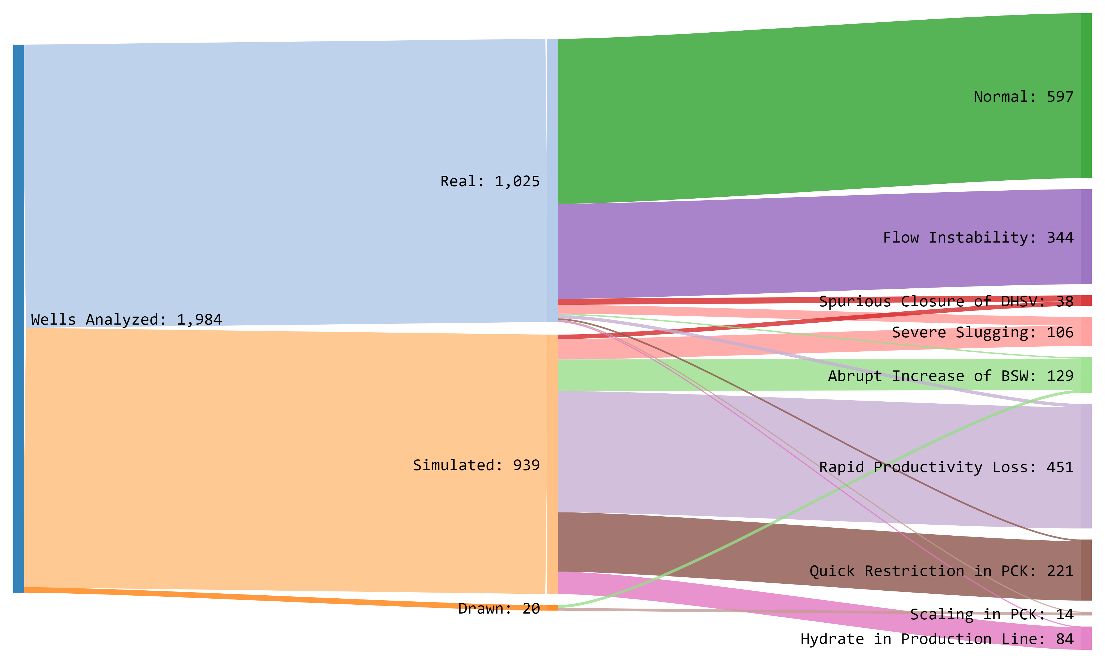
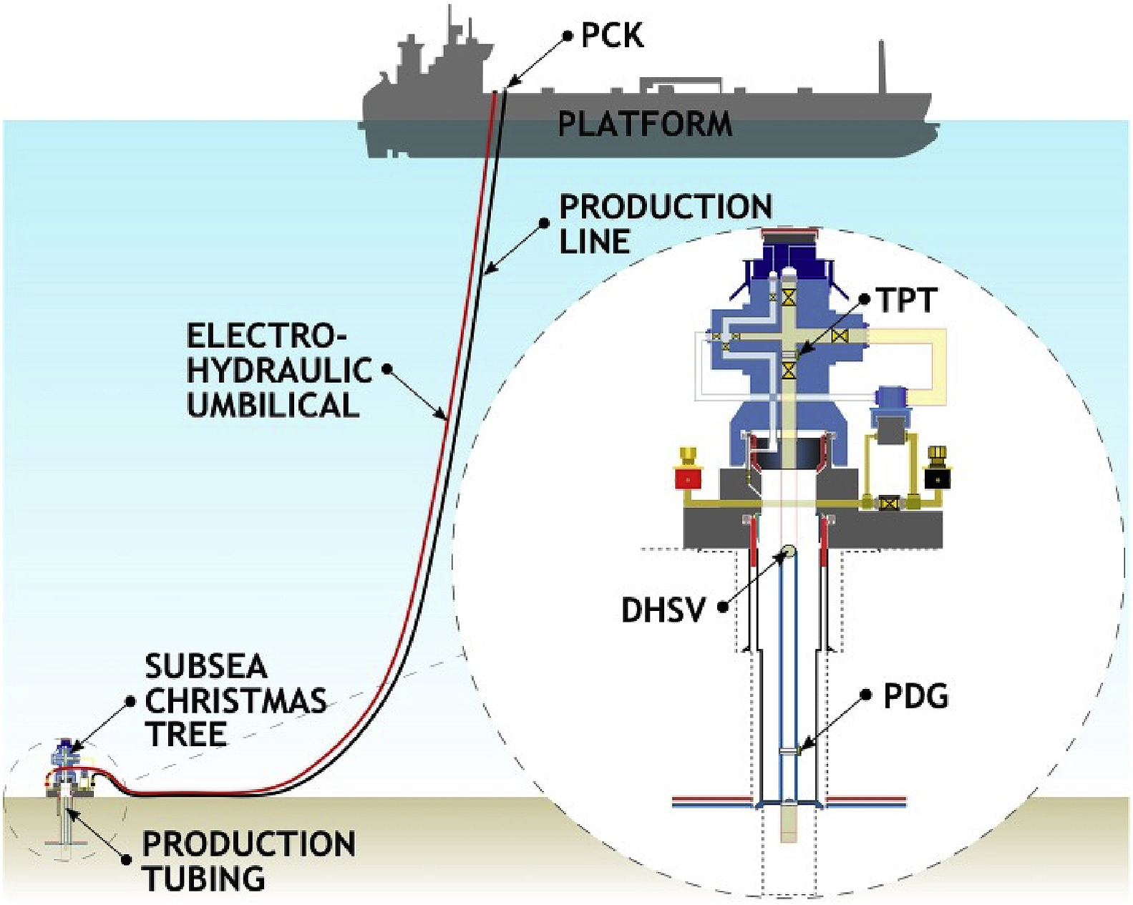
Understanding the Data
Division of Data
The 3W Dataset
Sponsored by Petrobras, nine petroleum engineers created the first realistic and public dataset on anomalies in Offshore Oil wells.
This data measures six different temperature and pressure metrics to track eight different undesirable events in three separate wells.
1,984 d_6 TimeSeries CSV files
14,091
Hours of Sensor Data
1 sec
Interval Between Measurements
Simplified schematic of a typical offshore naturally flowing well
by The Journal of Petroleum Science Engineering

Slide 3
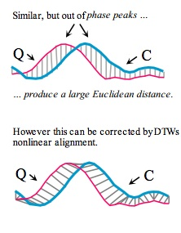
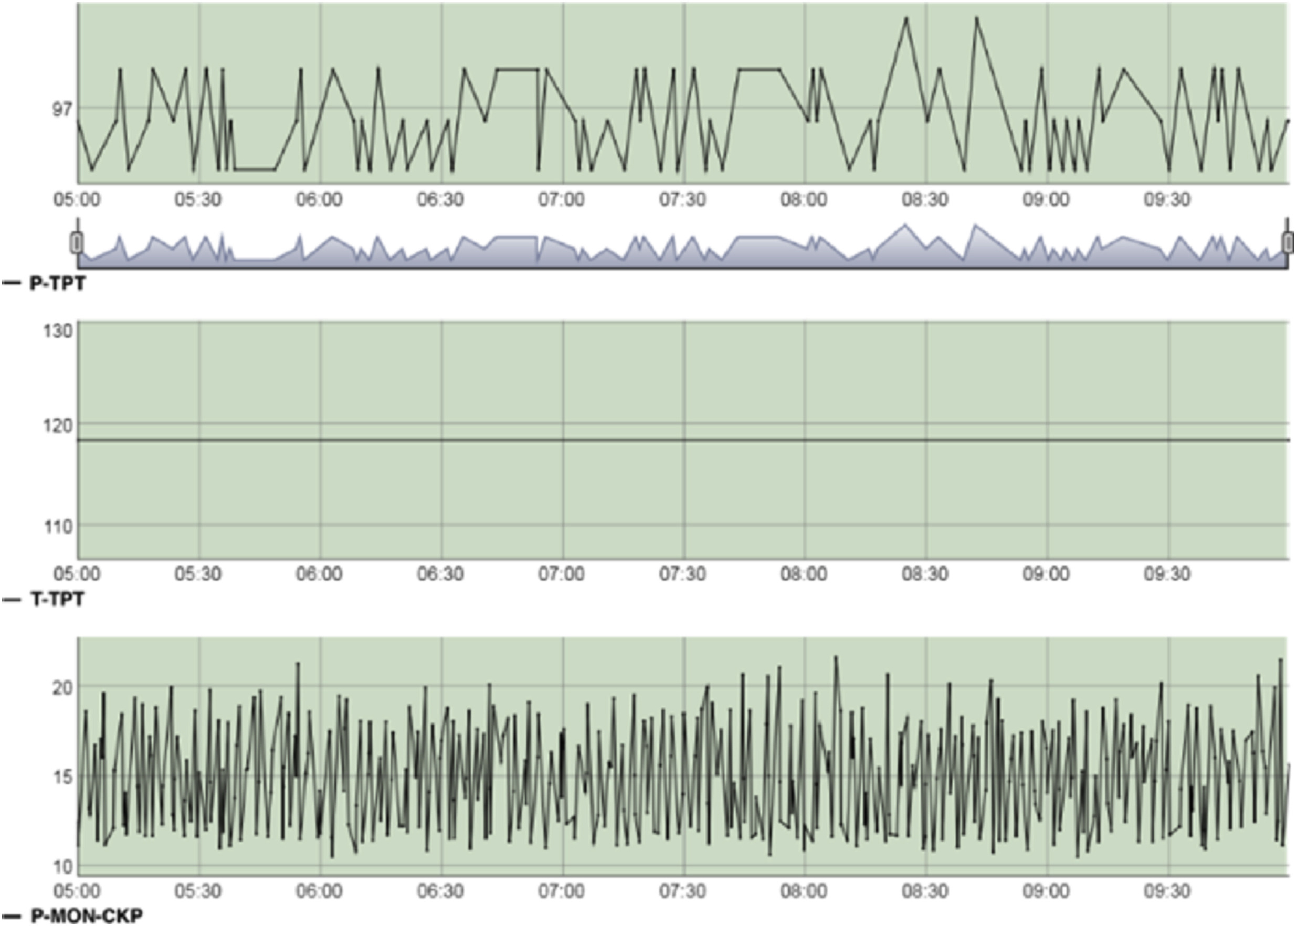
Methodology
1
Import dataset
(1, 60, 6)
x 845483
2
Separate by error type
Import
3
Separate by analysis type
Utilizing os module to organize 1984 csv files
into a dictionary
4
Remove N/A and frozen data
TimeSeries
5
Split into evenly timed data
Converting entire dataset into TimeSeries Dataframes
which are compatible with tslearn
6
Add to data frame dictionary
Cleaning
Cleaned excess of N/A data and converted changing class variable to static
ML Fitting
Utilize tslearn to run machine learning training with DTW and classification
Visualizations
Create Seaborn visualizations of the classification reports displaying model efficacy
Example of frozen temperature variable
by The Journal of Petroleum Science Engineering
Comparison of Euclidean vs DTW distance
by Ben Lorica, The Practical Quant

Slide 4
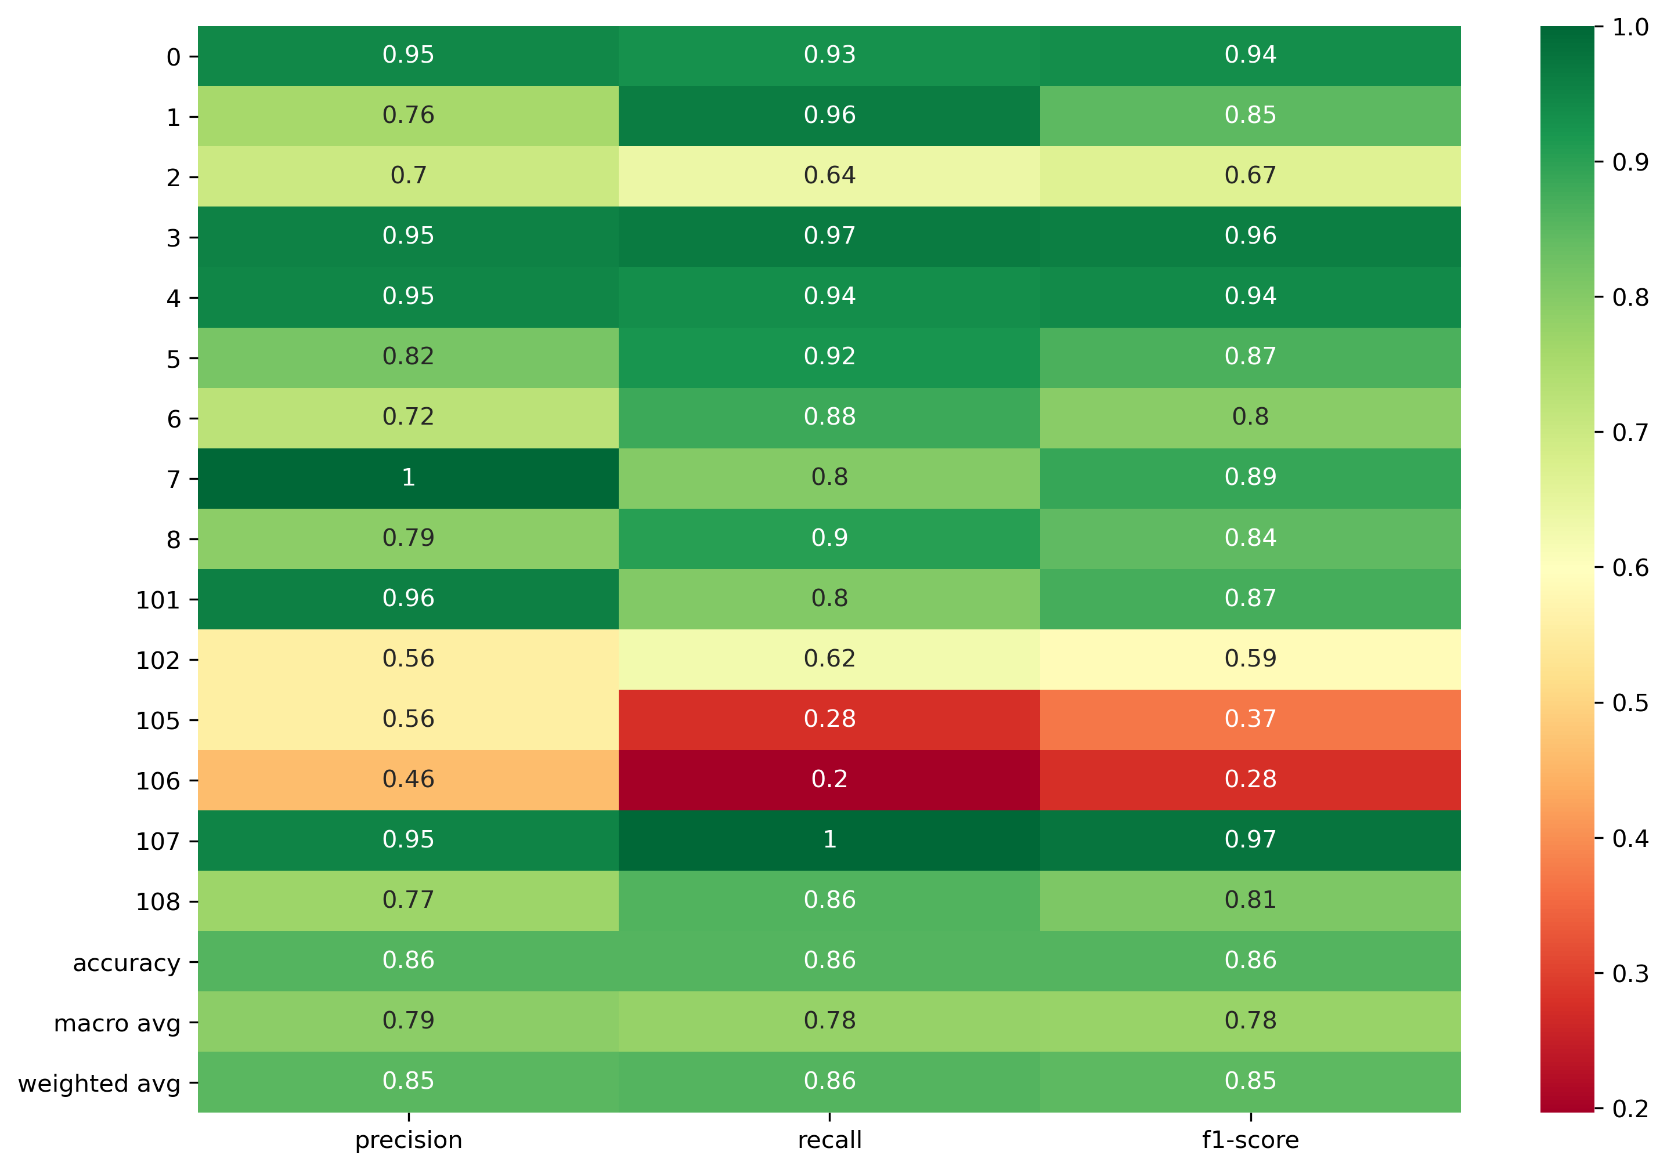
Results
The Guideline
Classifier Results:
We value the effectiveness of our models utilizing the weighted average F1-score, as it takes into acount precision, recall, and uneven class sizes.
KNN Classifier: (k = 3)
Dataset: (8454, 60, 6)
Weighted F1-Score = 0.85
Accuracy = 0.86
Effect of K on KNN Classifier
As the number of neighbors considered increases, the classifier begins to have a smaller F1-score (low bias).
In parallel referencing more neighbors allows a smoother analysis, which better accepts unknown inputs (low variance).
Dataset: (845, 60, 6)
The Classifier can deduce the state of an offshore well with 86% certainty.
Relevant shortcomings are in detecting Spurious Closure of DHSV (2/102)
and detecting progressive Rapid Productivity Loss (5).

Slide 5
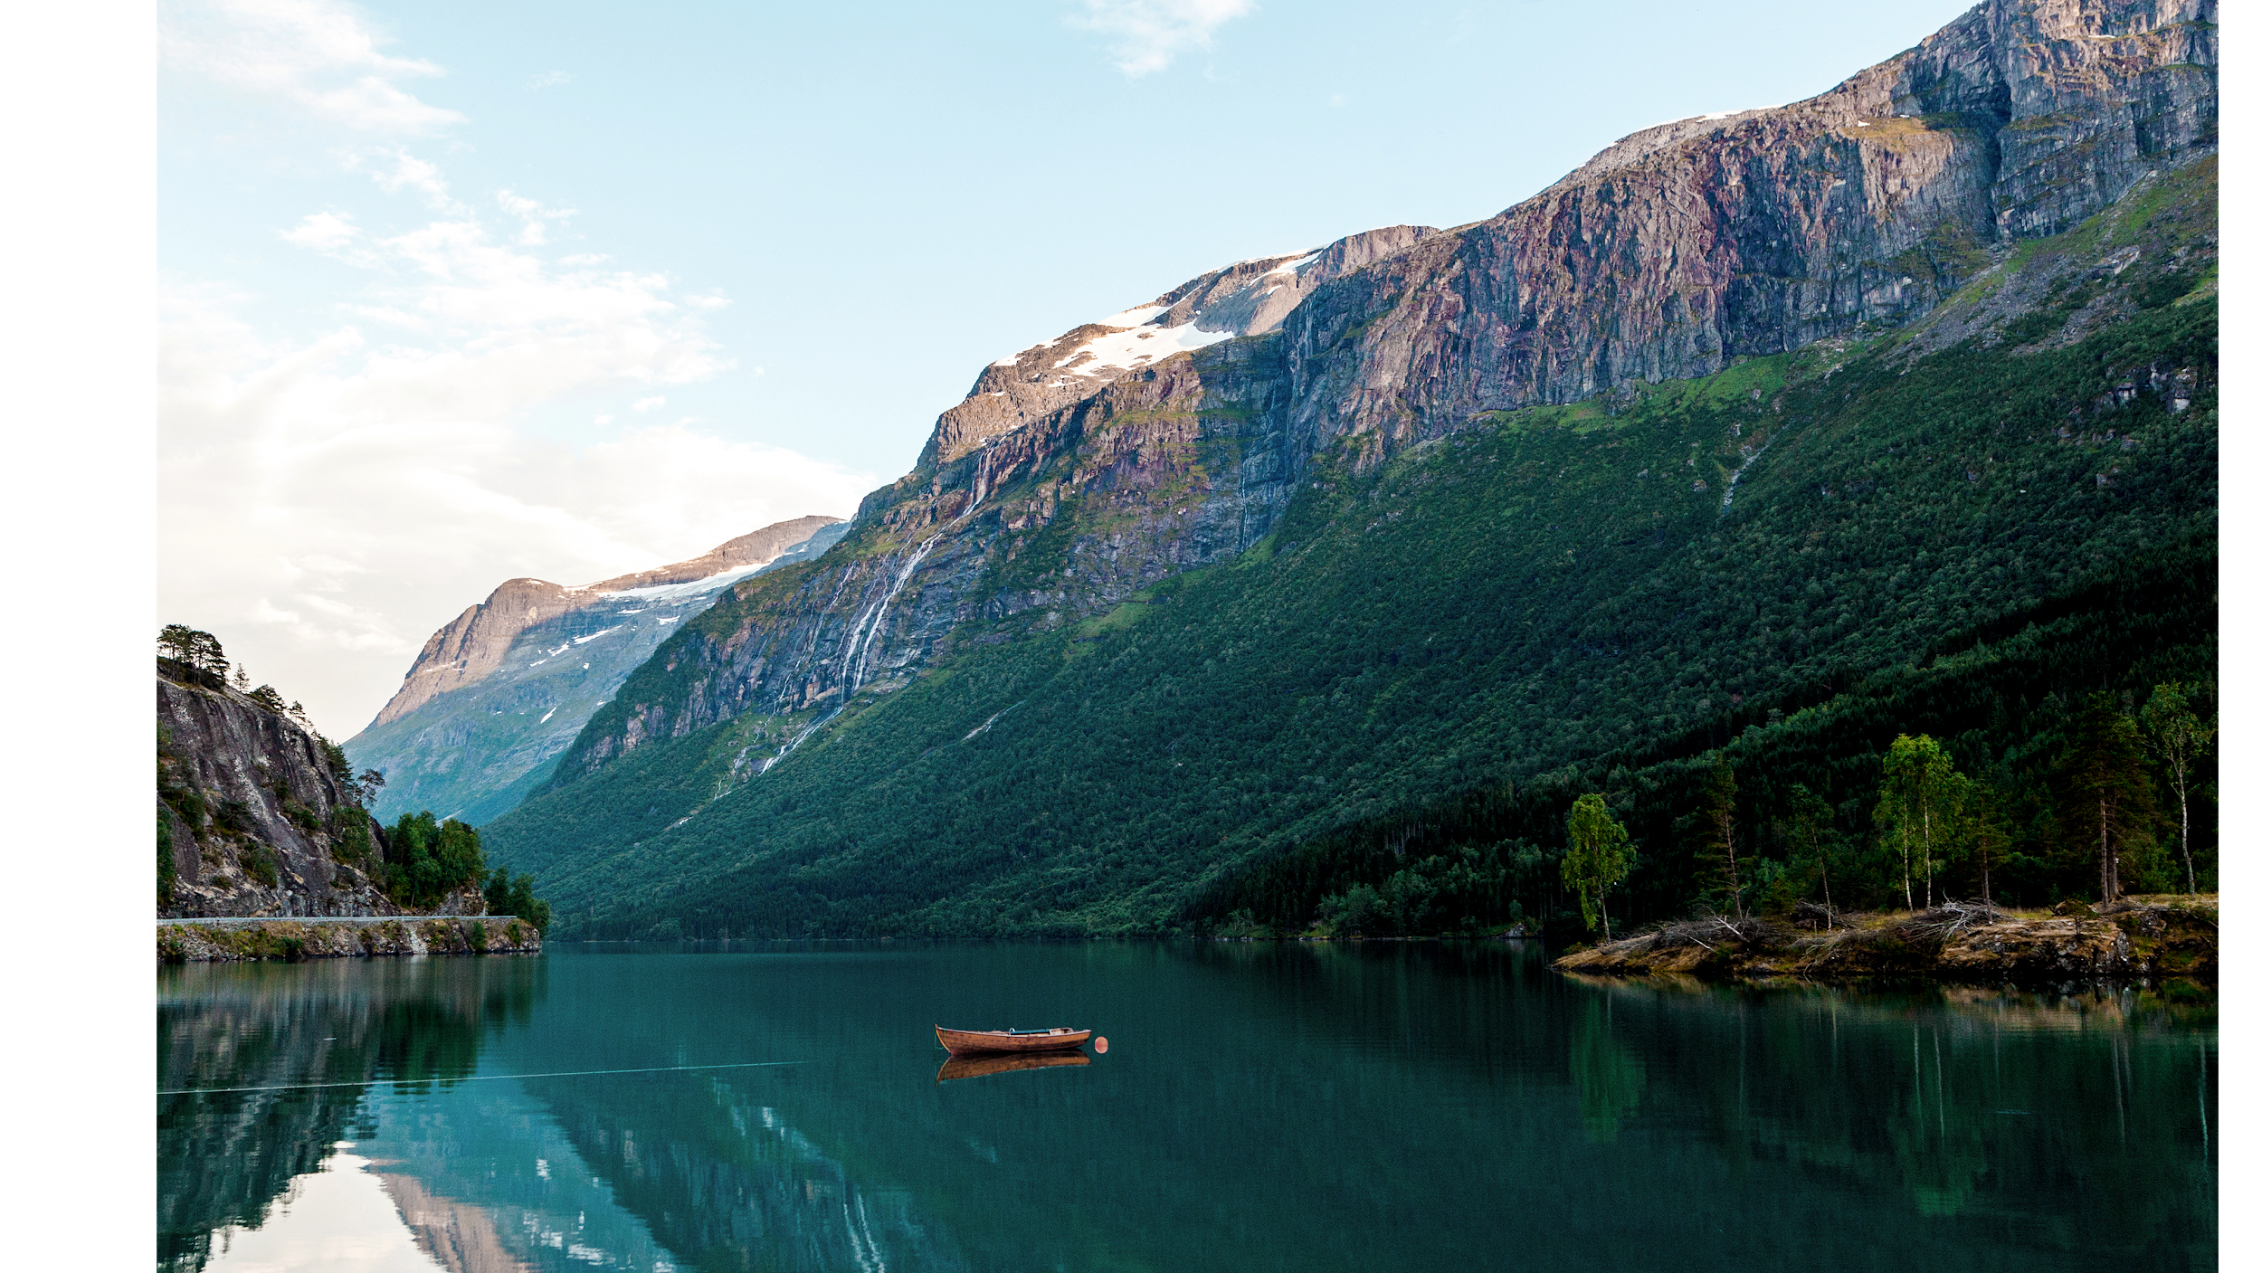

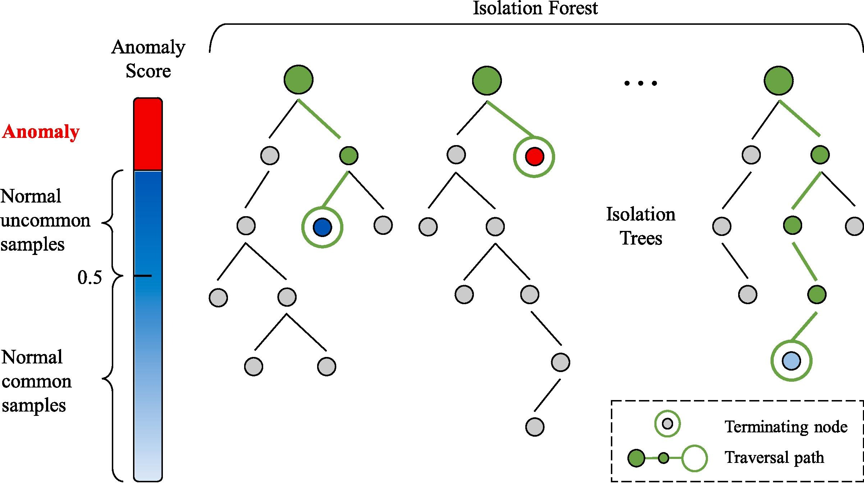

Looking Ahead
Cloud Computing Recourses
Unsupervised Learning
Eliminating False Negatives
Acquire stronger computing power with AWS or Azure to run greater portions of the dataset and
larger time samples with
increased accuracy.
Using unsupervised machine learning techniques such as random forest or isolation forest to better manage large sums of data. Additionally, consider implementing DTW to LightGBM for quicker results.
As anomalies in offshore oil extraction can cause dangers to well stability and security if left unchecked, prioritize minimizing type 1 error during training.
Visualization of Isolation Forest anomaly detection tree
by The Advanced Engineering Informatics

Slide 6
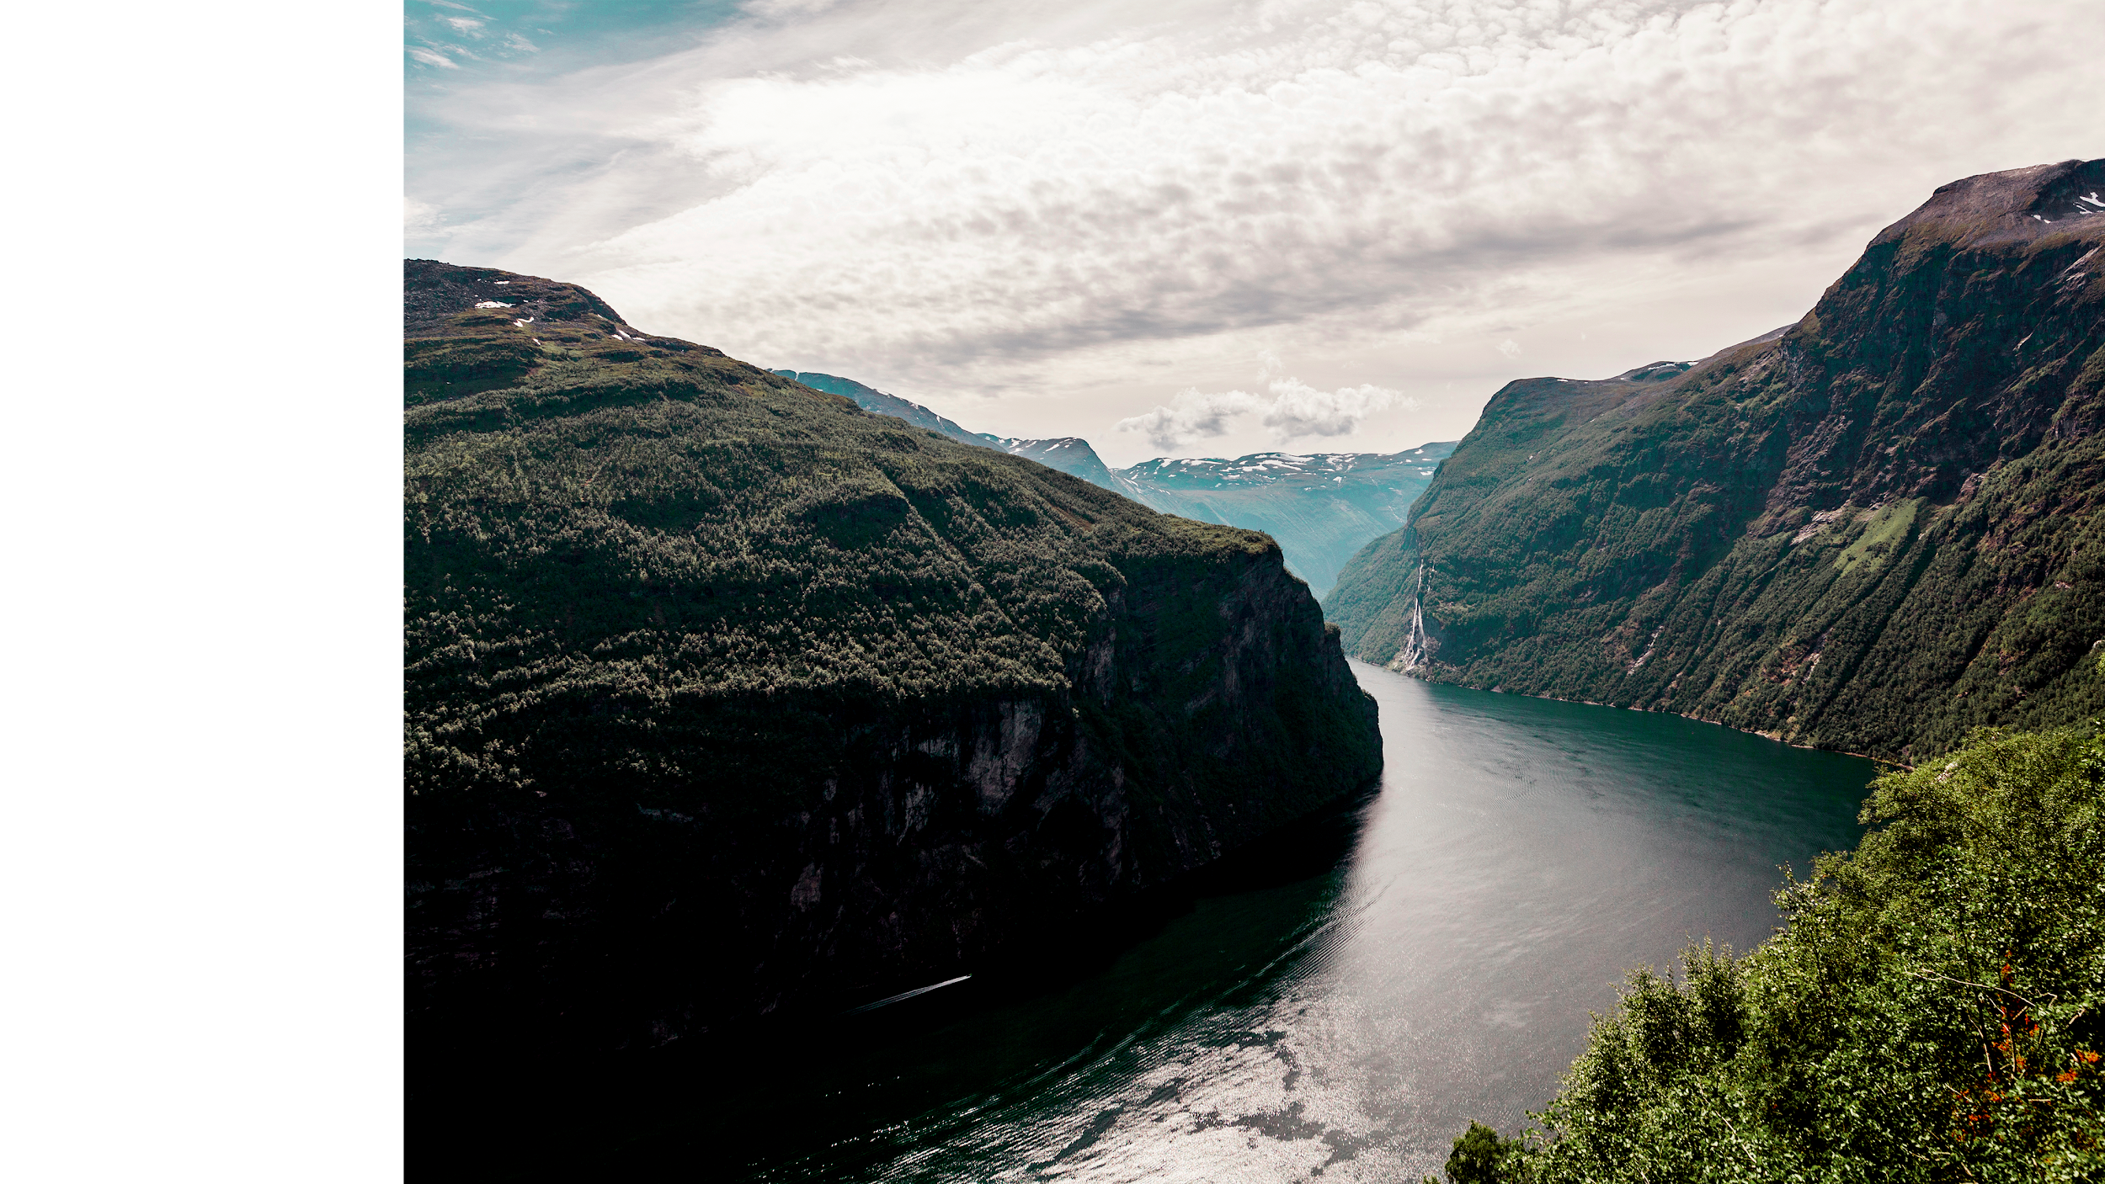
Thanks for watching!
Any further questions?
Contact me at:
Tortolani.mar@northeastern.edu www.linkedin.com/in/marcotortolani

Slide 7
CREDITS
This is where you give credit to the ones who are part of this project.
Presentation template by Slidesgo
Icons by Flaticon
Infographics by Freepik
Images created by Freepik - Freepik
Author introduction slide photo created by Freepik
Text & Image slide photo created by Freepik.com

Slide 8
RESOURCES
Did you like the resources on this template? Get them for free at our other websites.
VECTORS
Pack human resources 11
Pack social media 24
PHOTOS
Reflection of rocky mountains and sky on beautiful lake
Breathtaking view of sunnylvsfjorden fjord and famous seven sisters waterfall; norway
An elevated view of a businessman running downstairs
Two male businessman talking at workplace
Person looking at top of skyscraper
Red boat moored on the idyllic lake near the rocky mountains
Leopard
Rear view of a man with black backpack standing on bridge
Group of corporate people working in the office
Elegant man talking at phone low angle shot
Medium shot woman holding a tablet
Silhouette of a person's hand holding paper airplane against dramatic sky
Railway train tracks with platforms

